Slide 1


Chapter eight

Slide 2

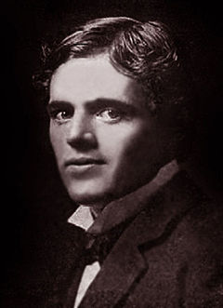
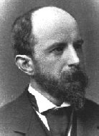
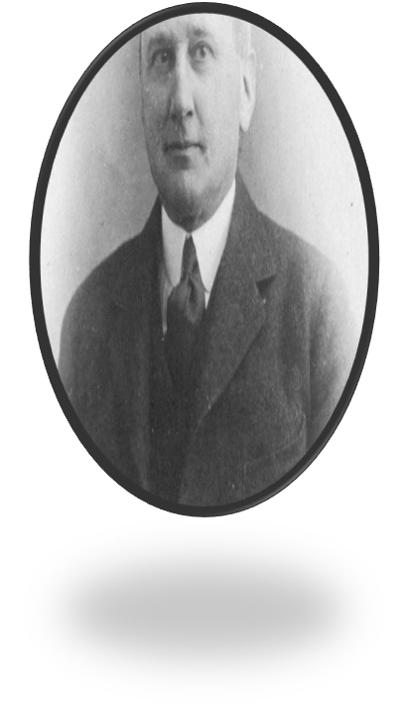
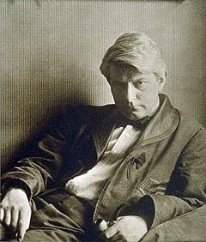
At The turn of the Century

Slide 3

By The Mid of 1880s:
-Rich businessmen had replaced the old “aristocrats of literature”, after the death of the old well-educated generation of Boston Brahmins.

Slide 4
By the end of the 19th century, Writers were greatly influenced by:
- Zola’s scientific study of men
- Darwin’s theory of evolution
- Frederic Nietzsche‘s philosophy against Christianity
Therefore, writers were beginning to think about the traditional social morality but in new way. This focus on individual who has to choose between good and evil

Slide 5
Henry Adams
Born Feb. 16, 1838, Boston.
Died March 27, 1918, Washington, D.C.
Historian, man of letters, and author of one of the outstanding autobiographies of Western literature, The Education of Henry Adams.

Slide 6
Henry Adams (one of the youngest Boston Brahmins ) was an American journalist, historian, academic and novelist. He is best-known for his autobiographical book, The Education of Henry Adams. He was a member of the Adams political family . In the 1880s, Adams also wrote two novels:

Slide 7
Historian and intellectual
In 1868, Henry Adams returned to the United States and settled down in Washington, D.C., where he started working as a journalist. Adams saw himself as a traditionalist longing for the democratic ideal of the 17th and 18th centuries. Accordingly, he was keen on exposing political corruption in his journalism.
In 1870, Adams was appointed Professor of Medieval History at Harvard, a position he held until his early retirement in 1877 at 39. As an academic historian, Adams is considered to have been the first (in 1874–1876) to conduct historical seminar work in the United States.
Adams's The History of the United States of America (1801 to 1817) has been called "a neglected masterpiece" by Garry Wills (Henry Adams and the Making of America).

Slide 8
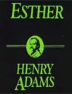
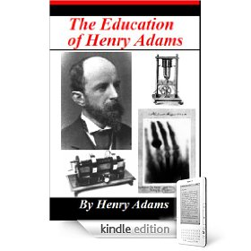

Slide 9
-Adams's The History of the United States of America is important book of both art and history. He used a poetic style to help his readers to feel the mood of the great events.
-In 1904, Adams published "Mont Saint Michel and Chartres," which is a guide book to two famous French religious sites, and a study of medieval society at the same

Slide 10
Born
March 5, 1870(1870-03-05)
Chicago, United States
Died
October 25, 1902 (aged 32)
San Francisco, California
Pen name
Frank Norris
Occupation
Novelist, Writer
Nationality
American

Slide 11
Frank Norris's work often includes depictions of suffering caused by corrupt. His writing style is also different from that of the other naturalists .Many of his techniques for description (his repetitious and powerful language) seem closer to such romantic writers as Hawthorne .

Slide 12
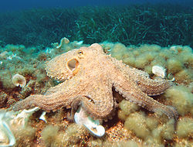
Scientific classification
Kingdom: | Animalia
Phylum: | Mollusca
Class: | Cephalopoda
Subclass: | Coleoidea
Superorder: | Octopodiformes

Slide 13
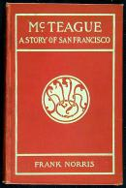
The octopus is a novel about the battle between California wheat farmers and the Southern Pacific Railroad .As in Mc Teague, we see the conflict between the power of nature (the farmers ) and a “inevitable” economic The forces.

Slide 14
AT the turn of the century were beginning to think about traditional social morality in a new way. Traditional values had been based on the idea of individual responsibility : the individual can and must choose between good and evil .But now writers were asking whether the individual could really make such a choice .When they looked at the many outside forces influencing a person , the area of individual choice and responsibility seemed quite small.

Slide 15
Jack London
.
Born January12 , 1876 San Francisco, california united states died november22, 1916 (aged 40) california united states occupation novelist , journalist ,short story writer .literary movement . Realism ,naturalism

Slide 16

His vigorous stories of men and animals against the environment, and survival against hardships were drawn mainly from his own experience. His best novel, The Sea-Wolf, was based on his experiences at sea. His work embraced the concepts of unconfined individualism and Darwinism in its exploration of the laws of nature. He died at age 40 of various diseases and drug treatments.

Slide 17
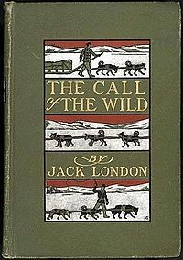
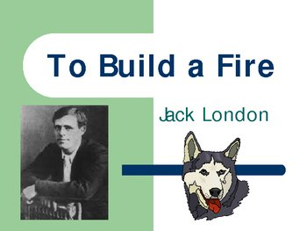
London’s works

Slide 18
The turn of the century was an exciting moment in American intellectual history .American novelists and poets were no longer simply copying British and European writers and European writers .They were now sharing ideas with the whole world .America was about to become an important contributor to world literature . A similar thing was happening in philosophy and sociology .John Dewey and William James developed their philosophy of ‘’Pragmatism’’.

Slide 19
Thorsten Veblen: made an important contribution to the growing attack on the capitalist economic and social system with his theory of the leisure class.

Slide 20
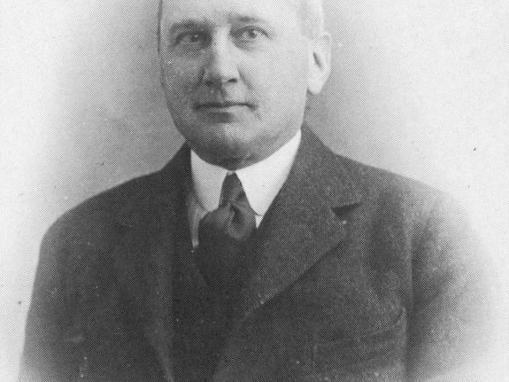
Robert Herrick

Slide 21
He seemed to have a tragic view of life.
he describes the evil growth of the “commercial spirit “in America from 1890s.
Like many writers after him, Herrick seemed to be filled with hopelessness and despair.

Slide 22
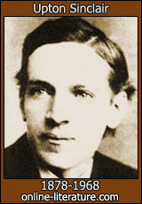
Upton Sinclair

Slide 23
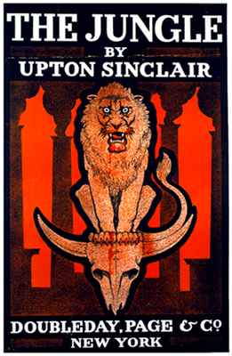
The famous Muckrakers, he believed in human goodness and was sure society could be changed.
His famous novel, the jungle ,was a successful weapon in his fight for justice.

Slide 24
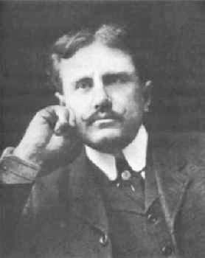
)
William S. Porter
"O. Henry" (1862-1910

Slide 25
O.Henry wrote short story a week. His famous collection of stories, Cabbages and Kings (1904 ).
His stories begin with action and move quickly toward their conclusion the are filled with deep, loving portrait of lives of ordinary people.

Slide 26
” “Progressive Era” “Muckraker Era
At the turn of the century the president announced that the government must lead a war against the nation’s political, social and economic evils.
But in newspapers. And literature from 1900 to 1914 this was the Muckrakers era” .

Slide 28
Now he began collecting Japanese ghost storiesn -His poetic styleusing words simply.
-Lafcadio Hearn didn’t simply translate the stories, he made them
into a new kind of literature.
- The Japanese attitude Kwaidan book.
Hearn’s attitude he wrote about both the good and bad in that country
He praises its old society and criticizes its new industrial society.
He also predicted the conflict between Japan and West.
-In the history of American literature, he is the man who mad the legends and tales of an unknown culture a part of our own literature.
Ghostly

Slide 29
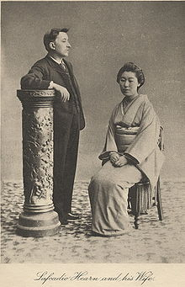
Later life in Japan
Lafcadio Hearn, shown with Koizumi Setsu. Note the way he is facing –
he always preferred to be photographed this way

Slide 30



THANK YOU

Slide 31

Presented by
Amal AL- Lebdi
Bedoor AL- Motairi
Reem Mohammad
Sara AL-Shaffee
Sara al -Rashedi

